Slide 1
MOVIE TICKET BOOKING
By
Nyi Nyi Myo Zin Htet (5918154)
Asif Rashid (5918186)

Slide 2
INTRODUCTION
We are presenting an easy C program which can make your movie experience in theatre much easy.
Our program can help anyone book or buy tickets in a theatre.
Anybody above the age of 10 can use this program.
You do not have to be a rocket scientist to operate this program.

Slide 3
PROJECT DESCRIPTION
This program required the use to the functions like:
do-while function
switch function
goto function
if-else function

Slide 4
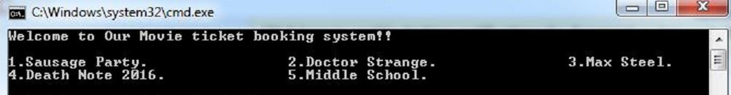
INSTRUCTION MANUAL
To book your favorite movie successfully you have to follow the following steps:
Step I: The program will show the names of the movies playing in the theatre.

Slide 5
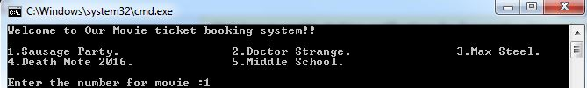
Step II: Enter the number assigned to your preferred movie

Slide 6

Step III: Then enter the number assigned to the day you prefer to watch the movie.

Slide 7

Step IV: Then enter the number for the given time you choose the time for the movie.

Slide 8

Step V: Then Enter the number of the seat type to choose the type of seat you want. (Enter 1 to book a VIP seat and 2 to book normal seat)

Slide 9

Step VI: Enter the number of seats you want to book

Slide 10

Step VII: Enter 1 if you want to book again

Slide 11
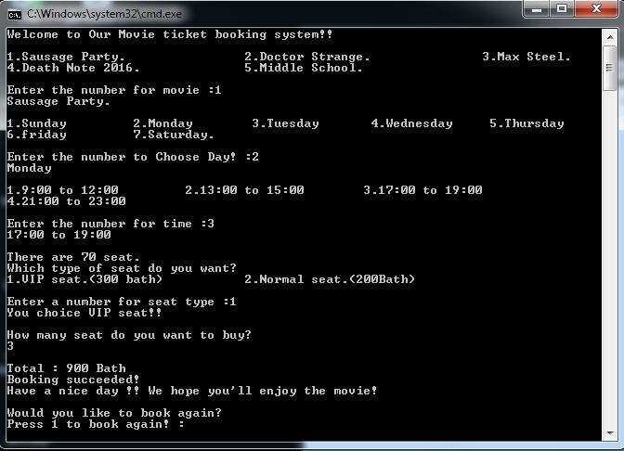
RESULT
Watching movie in a cinema theatre will never been so much easier than this.

Slide 12
CONCLUSION
Now you can enjoy movies in theatre in a much easy and sophisticated way.

Slide 13
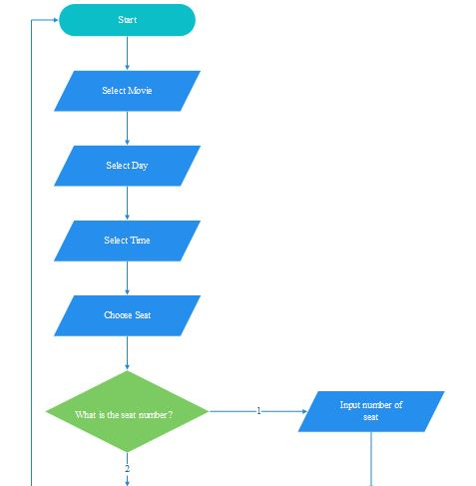

Slide 14
